Slide 1
Adhesives
How do adhesives work?
Mechanical adhesion
Chemical/Specific adhesion
Diffusion
Definitions
Adhesive types and uses
Requirements for a good bond

Slide 2
Samples Needed
A box of cereal – with the bag inside
A glass bottle with a plastic label
A glass bottle with a paper label
A chocolate bar
A bag of crisps

Slide 3
How Adhesives Work (Mechanical Adhesion) – CEREAL BOX
Wet out the surfaces to be bonded
Penetrate the surfaces
Interlock with the fibres
Create mechanical links
Produce fibre tear

Slide 4
Wetting Out - Basic Principle

Slide 5
How Adhesives Work (Specific or Chemical Adhesion) Glass Bottle
Wet out the surfaces to be bonded
Adhesive is attracted to the substrate surfaces
Positive and negative charges occur at the substrate surface
Force of attraction is at the molecular level - Van der Waals forces

Slide 6
Theories of Adhesion

Slide 7
Lets talk about the Samples
A box of cereal – with the bag inside
A glass bottle with a plastic label
A glass bottle with a paper label
A chocolate bar
A bag of crisps

Slide 8
Terminology
Viscosity
Tack
Open time
Setting time
Solids content

Slide 9
Viscosity
The resistance of a fluid to flow
The higher the viscosity the greater the resistance to flow
Typical unit of measure is centipoise (cps) or millipascal second (mPa x s)

Slide 10
Tack
The amount of stickiness
Resistance to pulling apart when adhesive is wet

Slide 11
Open Time
Maximum amount of time between when an adhesive is applied and when the substrates can be brought together and still make an effective bond.

Slide 12
Setting Time
The time from application of the adhesive to when an acceptable bond is developed.
This is usually the length of time that the bond must be under compression.

Slide 13
Solids Content
What is left when the liquid carrier medium (water or an organic solvent) has dried.
Measured in %
Hot melts are 100% solids, emulsions are about 50% solids and starch is about 30%.

Slide 14
Types of Adhesive
Starch
Casein
Synthetic emulsions
Solvent based
Cold seal
Pressure sensitive
Hot melts

Slide 15
Starch Adhesives
Made by chemical treatment of vegetable starches - maize, wheat, potato, Low solids content, Slow setting time, High tack
Withstand warm conditions
good for labelling warm/hot containers
Not good in cold and wet conditions
e.g. labelling cold bottles
Economical
used in corrugated board making – what bond is this mechanical/chemical/diffusion?

Slide 16
Casein Adhesives
Derived from the phosphoprotein in acidified milk. Absorb large quantity of water without significant change in viscosity good for applying labels to bottles in cold and wet conditions.
Very high tack -Good for applying labels to curved surfaces.
Good resistance in use to cold water
e.g. labelling of bottles which will be cooled in iced water
Chemical/mechanical/diffusion ?

Slide 17
Synthetic Emulsions
Based on polymers
eg. polyvinyl acetates, acrylates and maleates.
Solid adhesive particles are surrounded by a protective colloid, and the whole surrounded by water.
High solids ~ 50-75%

Slide 19
How water based adhesives work
Starch/casein/water based emulsion
Set by the loss of water
Suspension breaks
Individual polymer ? units combine to form an adhesive film
Partial or green bond is formed
Bond strength increases as water evaporates

Slide 20
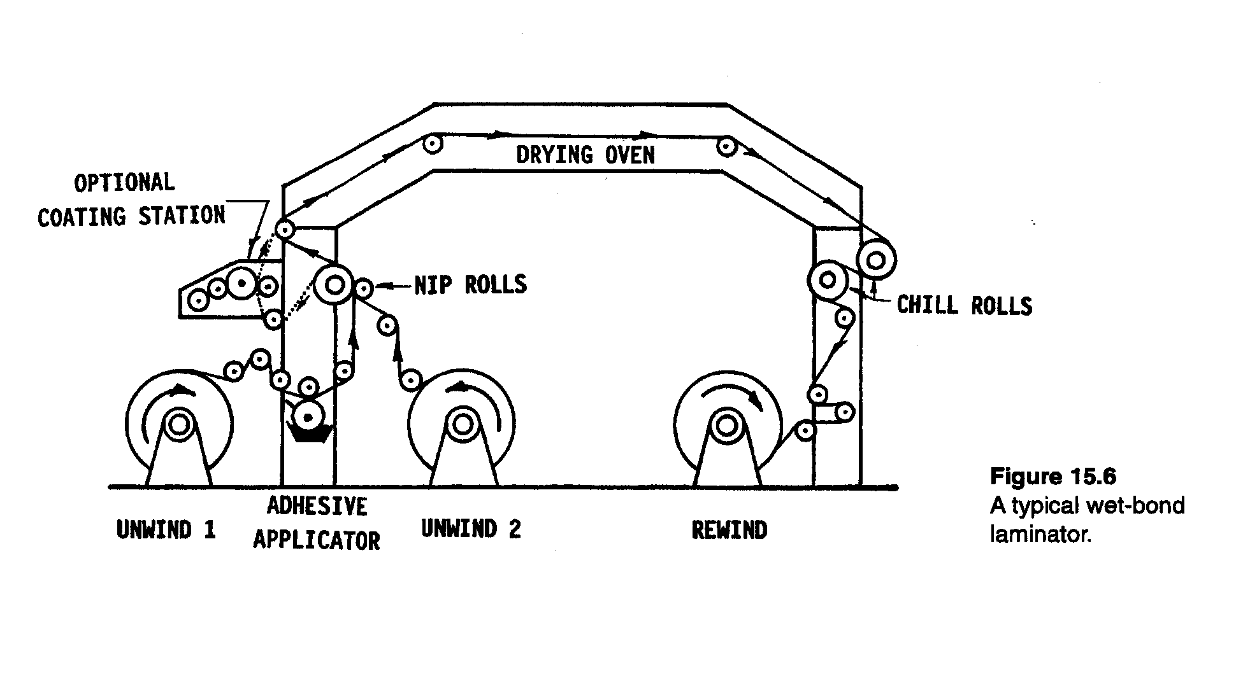
How water based adhesives work
One substrate must be porous
e.g. Wet bond lamination of flexible packaging materials

Slide 21
Solvent Based Adhesives
Used to combine single webs of flexible materials into required structure
Risk of retained solvent
Need for solvent recovery or solvent burning plant

Slide 22
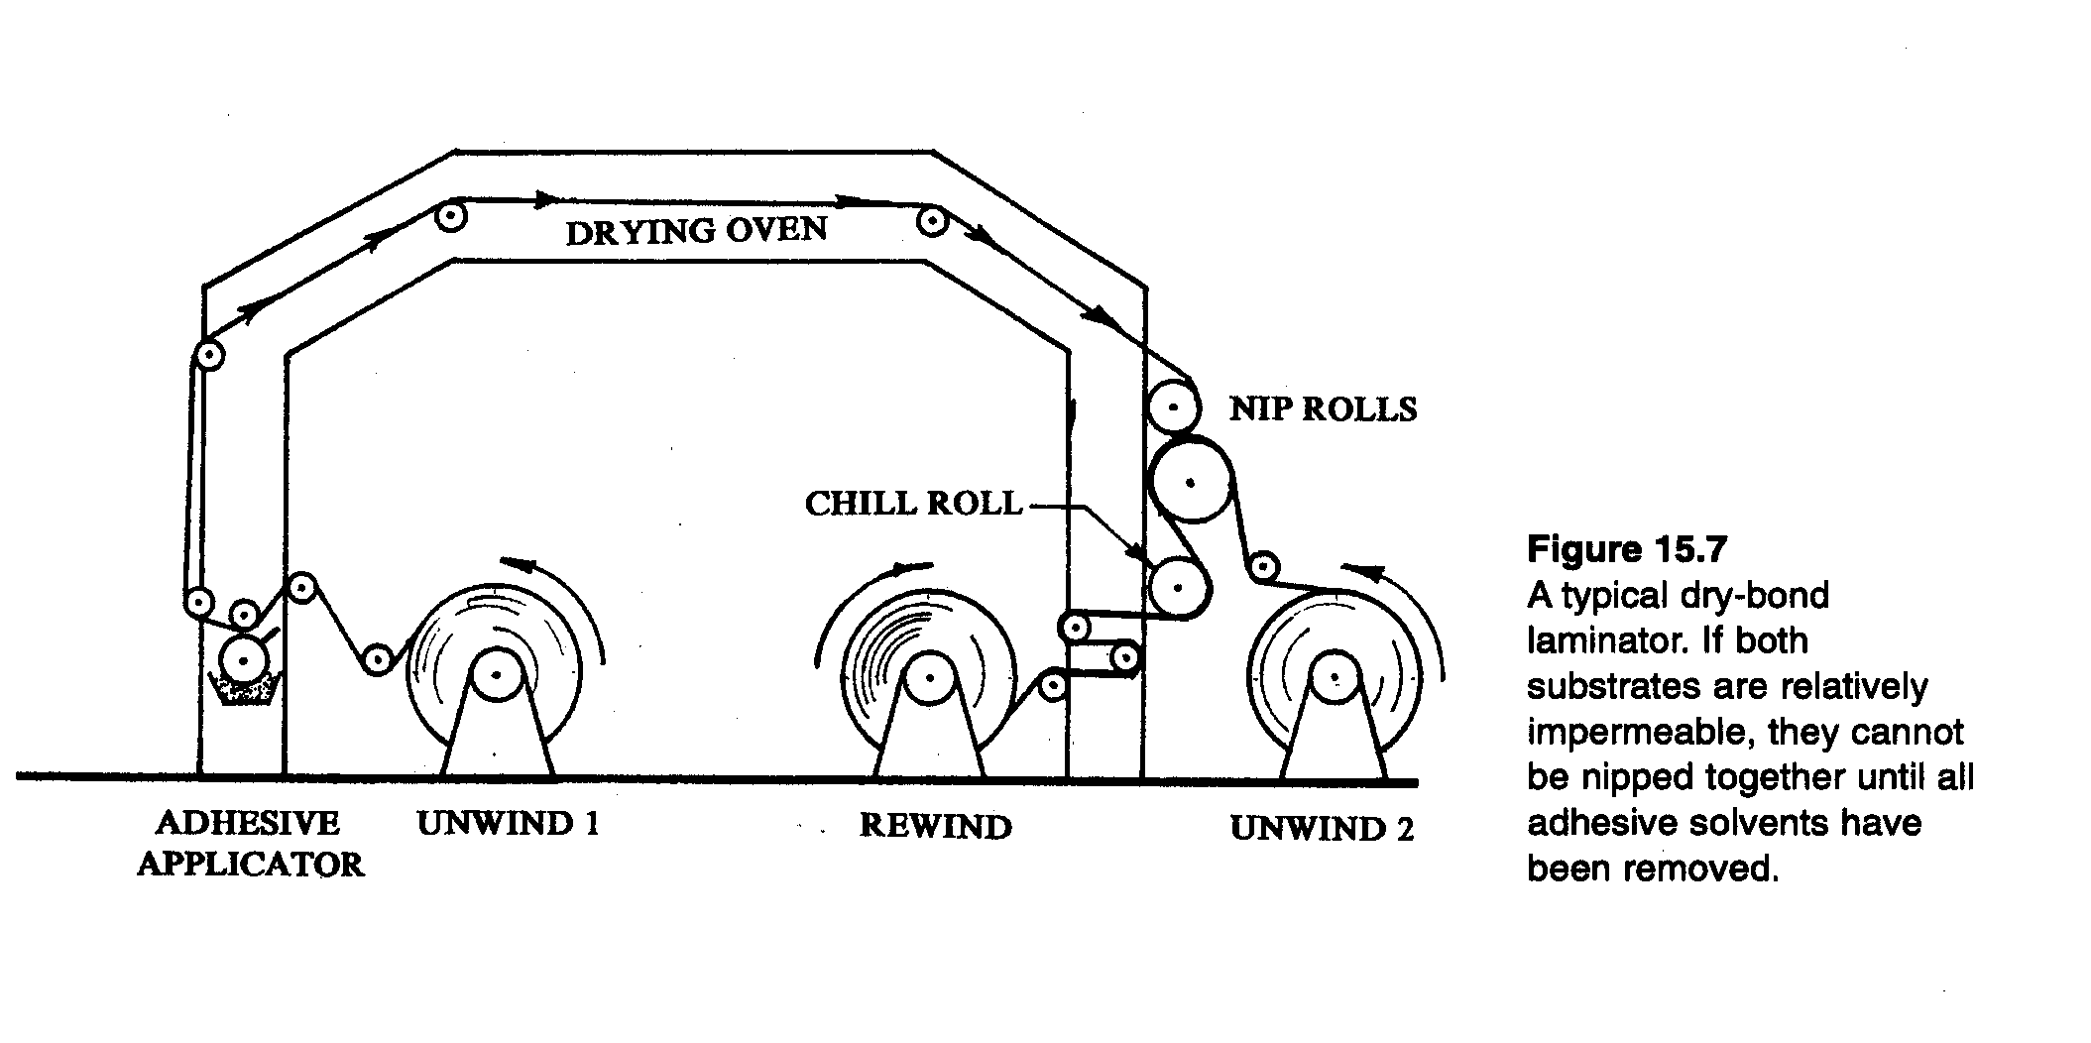
Dry Bond Lamination

Slide 23
Pressure Sensitive Adhesives
Acrylic or rubber-type materials
Form instant bond
Can be peelable or permanent
Used on self adhesive labels

Slide 24
Cold Seal Adhesives
Latex based
Only adheres to itself
Applied to the reverse of a printed film, in register to seal areas
Needs only pressure to bond
Does not give airtight seal

Slide 25
Hot Melt Adhesives
Synthetic materials based on:
Polymers - for strength
Resins - for tack and adhesion
Wax - as diluent
Stabilisers
Antioxidants
Thermoplastic - soften on heating, solidify on cooling

Slide 26
Hot Melt Adhesives
100% solids - no solvent to dry
Fast setting - short compression time
Good for rough surfaces - fill gaps
Small space requirements
Immediate use of the pack
Limited heat resistance
Continuous energy requirement
Fuming & charring + burn hazard
Development of warm melts

Slide 27
What happens as a Hot Melt cools
160
Temp
°C
LIQUID
100
PLASTIC
50
SOLID
Time (secs)

Slide 28
Comparison of Starch/Emulsion/Hot Melt
O
O
O
O
O
O
O
O
O
OO
O
O
O
O
O
O
O
O
O
O
O
O
O
O
O
O
O
O
O
O
Starch
Emulsion
Hot Melt
% Solids
30
55
100
SPEED
PENETRATION
HEAT RESISTANCE
WATER RESISTANCE
GAP FILLING
ADHESION

Slide 29
Requirements For a Good Bond
Apply just enough adhesive
Apply to correct place
Adhesive must wet out the substrate
Adhesive must be liquid (or molten) when substrates are brought into intimate contact

Slide 30
Requirements For a Good Bond
Substrates must be held together until bond has formed
Temperature and humidity of factory and substrates affect setting time
Keep adhesive and applicator clean at all times

Slide 31
What New ?
Plastics Tax – good news for adhesives
Cool Melts 170 to < 100
Bio Melts –ve CO2
Pop and Lock decreases use of plastics
Stitching

